Slide 1
Data Analysis, a brief story
Showcasing a day in my life as an analyst in 10 minutes
Andrea Sabia
24th January 2023

Slide 2



To impress any stakeholder, it is fundamental to listen to their request, ensure to understand success criteria, and frame the problem before diving head-first into it
Request
Framing the problem / Brainstorming
Before diving into the data, i thought long and hard as to what would impress my stakeholders, based on the situation presented and knowledge available
Often times stakeholders may be unclear or too broad in their request, or the request as is may not be doable due to technological constraints
Showcase my skills in terms of thought process, data manipulation, analysis, data visualization and presentation, by answering the following question:
Which is the best european city to live in?

Slide 3



Having access to the right data through an automated pipeline is key to ensure accuracy and repeatability of the results for future iterations on the request
Extract
Transform
Load
I developed a web scraping algorithm to automatically extract the data for the top 10 cities in the 13 biggest countries in europe from the website “Numbeo.com”
The extracted data presented irregularities which needed to be addressed before analysis could take place. The two biggest issues were missing data, and various different currencies
The data extracted and transformed using Python was loaded directly into a Google Sheet, and automatically picked up by Tableau

Slide 4
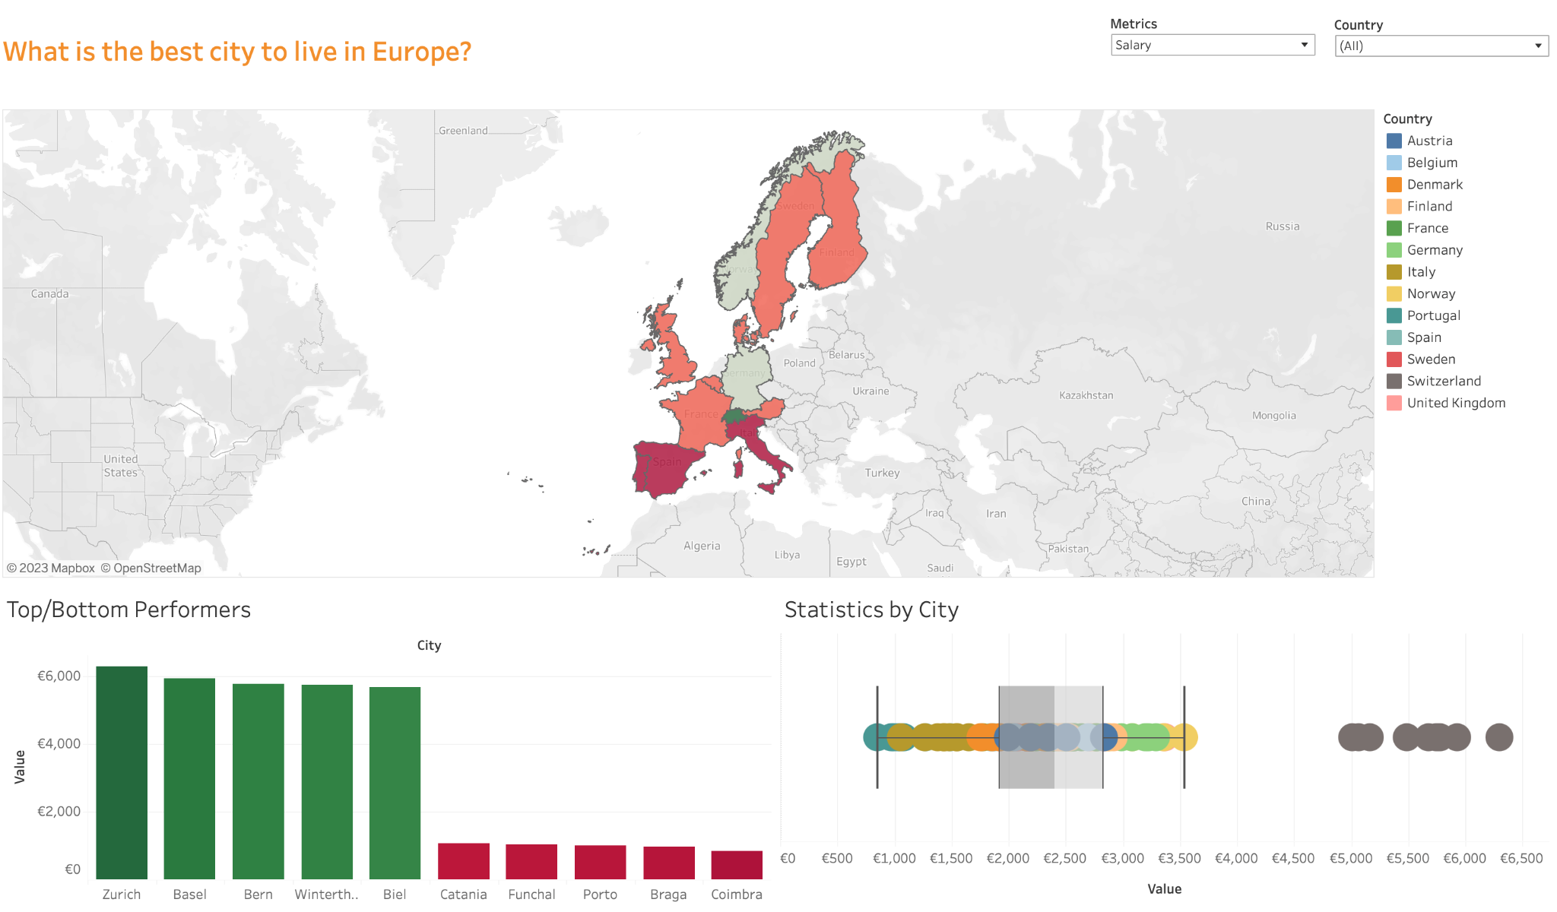


At this stage, analyst and stakeholder will come together to see the results and play together to extract the most impactful insights
Visualize / Analyze
Sharing
All the work done cannot be left to dust, we need to share the information efficiently with anyone who may need it, in the best possible format

